Slide 1
CNENGR 228
Digital Electronics
Lecture 2 – Field Programmable Gate Arrays
Dr Zhongming Zhang
School of Engineering
Lancaster University

Slide 2
Objectives
  Understand the architecture of FPGAs
  Understand the concept of LUT
  To be able to map a circuit to FPGA manually

Slide 3
Programmable Logic Devices (PLDs)
Digital IC
PLDs
ASIC
SPLD
CPLD
FPGA
Semi-Custom
Full-Custom
PLA
PAL
Standard Cell
Gate Array

Slide 4
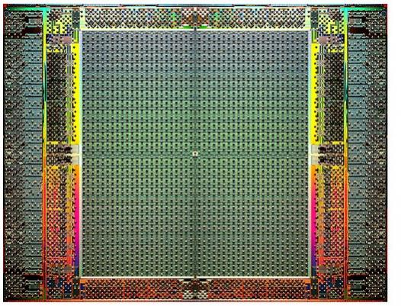
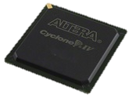
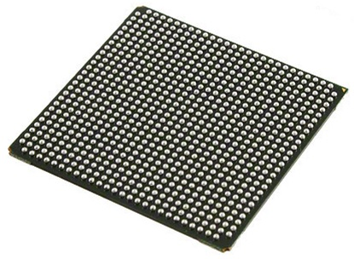
1. FPGA Architecture
  FPGA stands for Field Programmable Gate Array
  There is no “Gate Array” inside the FPGA
  Programmable in the “Field” (e.g. your laboratory, rather than requiring fabrication)
Manufacturers
  Altera (Cyclone series)
  The Xilinx (Spartan series)
  Actel and Lattice
?
Courtesy of Altera
(Stratix IV FPGA)

Slide 5
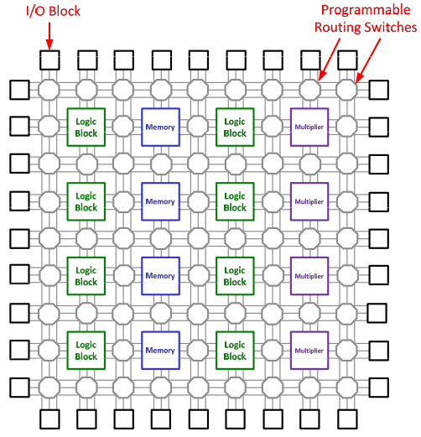
1.1. FPGA Architecture
Logic Array Blocks (LAB)
  General logic blocks
  Memory blocks
  Multiplier blocks
Programmable Switching Matrices
  Programmable horizontal/ vertical routing channels
  Connecting blocks together and I/O
I/O Blocks
  Connecting the chip to the outside

Slide 6
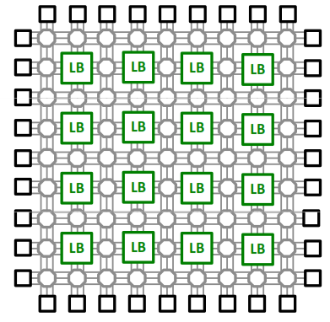
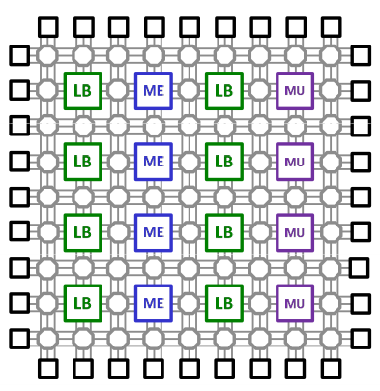
1.2. FPGA Categories (Structure)
Homogeneous
Employ only one type of logic block
Connecting blocks together
Heterogeneous
Employ mixture of different blocks such as dedicated memory/multiplier
Very efficient for specific functions
Notes:
Homogeneous – of the same kind
Heterogeneous - diverse in character or content (i.e. different building blocks)

Slide 7
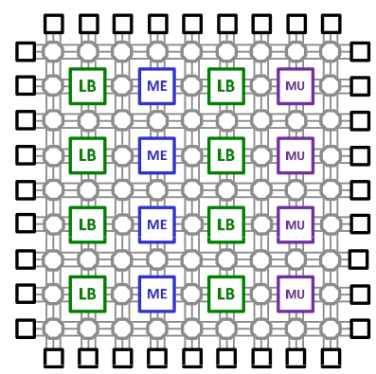
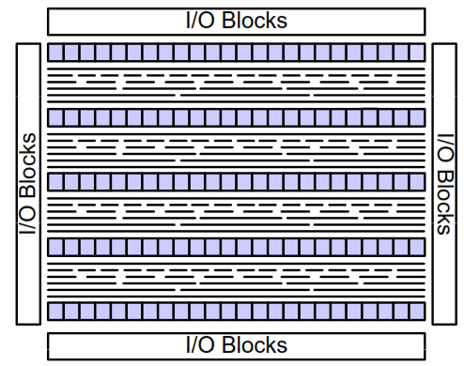
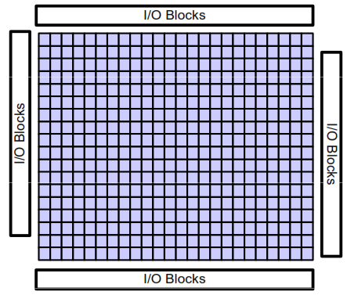
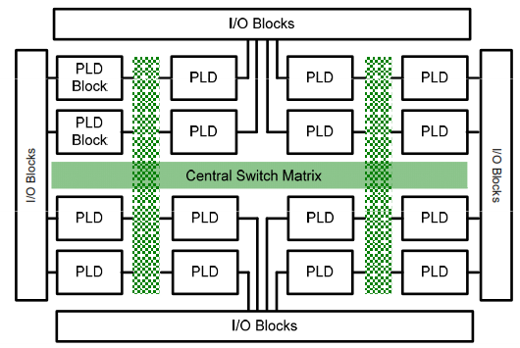
1.2. FPGA Categories (Floor Plan)
Symmetrical Array
Row-Based
Sea-of-Gate
Hierarchical PLD
Notes:
In electronic design automation, a floorplan of an integrated circuit is a schematic representation of tentative placement of its major functional blocks.
In modern electronic design process floorplans are created during the floorplanning design stage, an early stage in the hierarchical approach to integrated circuit design.
Depending on the design methodology being followed, the actual definition of a floorplan may differ.

Slide 8
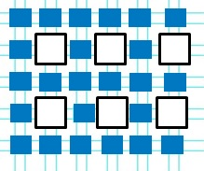
1.3. FPGA Logic Elements
Logic Array Blocks (LAB)/Configurable Logic Blocks (CLB) are made of a series of Logic Elements (LE)
Logic elements are the most important blocks of an FPGA which provides the basic computation and storage elements used in logic systems
select
Out
In1
Flip-flop
In2
4-LUT
In3
D
Q
In4
Clock
Logic Element (LE)

Slide 9
1.3. FPGA Logic Elements
Cyclone-series logic elements
select
Out
In1
Flip-flop
In2
In3
4-LUT
D
Q
In4
Clock
Logic Element (LE)

Slide 10
1.3. FPGA Logic Elements
4-Look Up Table (4-LUT)
a
b
c
d
F
0
0
0
0
0
0
0
0
1
0
0
0
1
0
0
select
0
0
1
1
0
0
1
0
0
0
Out
0
1
0
1
0
0
1
1
0
0
a
Flip-flop
0
1
1
1
0
b
1
0
0
0
0
c
4-LUT
D
Q
1
0
0
1
0
d
Clock
a
b
f = (ab)'c'
c
Notes:
3, 4 or 5 input LUT any Boolean algebra can be created with the same number of inputs

Slide 11
1.4. Modern Commercial FPGAs
IO cells
PLL
Clock Manager
Logic array block
(LAB)
…
SRAM block
…
…
…
DSP
…
…
…
…
…
Logic element
LAB
Programmable
switch
Notes:
A phase-locked loop or phase lock loop (PLL) is a control system that generates an output signal whose phase is related to the phase of an input signal. There are several different types; the simplest is an electronic circuit consisting of a variable frequency oscillator and a phase detector in a feedback loop. The oscillator generates a periodic signal, and the phase detector compares the phase of that signal with the phase of the input periodic signal, adjusting the oscillator to keep the phases matched.
A digital signal processor (DSP) is a specialized microprocessor (or a SIP block), with its architecture optimized for the operational needs of digital signal processing.

Slide 12
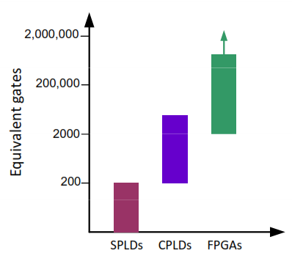
1.4. Circuit Size Metrics
Size metrics
  How many basic gates can be built on the circuit
  Common measure: number of two-input NAND gates
Device | Size | Design Type
SPLD | ~200 gates | Small
CPLD | ~10,000 gates | Moderate
FPGA | ~1,000,000 gates | Large

Slide 13

2. FPGA Lookup Tables (LUTs)
Look Up Table (LUT)
  Use a set of 1-bit storage elements to implement logic functions
Example
  A 2-input LUT
  Capable of implementing any logic function of two
SRAM cells
4x
1 Mem.
x
y
F
1
rd
0
0
1
0
1
0
1
0
1
0
F
1
0
0
2
0
1
1
1
3
1
$$F=x^{′}y^{′}+xy$$
x
y
Notes:
Static random-access memory (static RAM or SRAM) is a type of semiconductor memory that uses bi-stable latching circuitry (flip-flop) to store each bit. SRAM exhibits data remanence, but it is still volatile in the conventional sense that data is eventually lost when the memory is not powered.

Slide 14




2. FPGA Look up Tables (LUTs)
One function = 1-bit wide memory
Two functions = 2-bit wide memory
4x
1 Mem.
4x
2 Mem.
1
rd
x
y
F
G
1
rd
0
10
0
1
0
0
1
0
1
1
00
1
0
0
1
0
0
2
0
1
0
0
2
01
1
3
10
x=0
3
1
1
1
1
0
x
a1
a1
y
a0
D1
D0
a0
D
y=0
F=1
$$F=x^{′}y^{′}+xy$$
$$F$$
$$G$$
(a)
$$G=xy^{′}$$
(b)

Slide 15

2.1. Example 1
Determine the suitable size of Look Up Table to map the combinational logic circuit below into an FPGA
Beltwarn
3-input LUT or 8x1 Mem.
k
p
s
F
k
0
0
0
0
0
0
1
0
0
0
1
0
programming
in seconds
2
0
p
F
0
1
0
0
0
k
a2
3
0
1
1
0
p
4
0
1
0
0
0
a1
0
s
s
a0
5
1
0
1
0
6
1
1
1
0
1
7
0
$$F=kps′$$
1
1
1
0
D
F
ab
IC
F
(a)
(b)
(c)

Slide 16


2.2. Managing the Size of LUTS
Lookup tables become inefficient for more inputs
  3 inputs → only 8 cells
  8 inputs → 256 cells
  16 inputs → 65,536 cells!
FPGAs thus have numerous small (3, 4, 5, or even 6-input) LUTs
  If circuit has more inputs, must partition circuit among LUTs
k-input
LUT
$$2^{k}$$
F
-bit
$$k$$

Slide 17

2.3. Example 2: Mapping into 3-input LUTs
Consider the circuit shown below as an extension of Example 1
  For now, we assume it is possible to create any wires to/between LUTs
  5-input circuit, 3-input LUTs available
  Partition the circuit and map it into 3-input LUTs
8x1 Mem
8x1 Mem
k
BeltWarn
0
0
1
1
p
F
2
2
a2
3
a2
3
s
4
4
a1
a1
t
a0
5
a0
5
6
6
d
7
7
D
D
$$F=kps^{′}+t+d$$
F2
F2

Slide 18



2.3. Example 2: Solution
Step1: Divide the circuit or the corresponding Boolean function into two parts each with 3 inputs.
$$F=kps^{′}+t+d$$
$$F1=x=kps^{′}$$
8x1 Mem
8x1 Mem
0
0
$$F2=x +t+d$$
1
1
2
2
a2
3
a2
3
k
BeltWarn
a1
4
a1
4
p
x
a0
5
a0
5
F
6
6
s
7
7
t
D
D
F1
F2
d

Slide 19



2.3. Example 2: Solution
Step 2: Assign the required variables to the inputs of Look Up Tables and fill them in with the output of the logic functions
$$F=kps^{′}+t+d$$
8x1 Mem
8x1 Mem
0
0
0
0
$$F1=x=kps^{′}$$
1
0
1
1
$$F2=x +t+d$$
2
0
2
1
k
a2
3
0
x
a2
3
1
p
a1
4
0
a1
4
1
k
BeltWarn
5
0
t
5
1
s
a0
1
d
a0
1
p
x
6
6
F
7
0
7
1
s
D
D
t
F1
F2
d

Slide 20



2.3. Example 2: Solution
Step 3: Draw the wires between the different LUTs
$$F=kps^{′}+t+d$$
8x
1
Mem.
8x
1
Mem.
0
0
0
0
$$F1=x=kps^{′}$$
1
0
1
1
$$F2=x +t+d$$
2
0
2
1
3
0
x
3
1
k
a2
4
0
a2
4
1
BeltWarn
p
a1
a1
k
s
a0
5
0
a0
5
1
p
x
6
1
6
1
F
7
0
7
1
s
D
D
t
t
d
d
F

Slide 21
3. FPGA Switching Matrices
Programming the connections between LUTs instead of being hardwired.
Use switch matrices (also known as programmable interconnect).
8x2 Mem
FPGA
8x2 Mem
0
0 0
0
0 0
1
0 0
1
0 0
2
0 0
2
0 0
P0
3
0 0
3
0 0
a2
4
0 0
a2
4
0 0
P2
a1
a1
a0
5
0 0
a0
5
0 0
P1
0 0
0 0
6
6
7
0 0
Switch
matrix
7
0 0
D1
D0
D1
D0
m0
o0
Q0
P3
m1
o1
m2
Q1
P4
m3
o2

Slide 22
3.1. Multiplexer Version
A 2-bit memory is required to program each 4-1 multiplexer
Switching matrix
2-bit mem
FPGA
8x2
Mem
8x2
Mem
m0
s1
s0
0
00
0
00
m1
i0
o0
1
00
1
00
m2
i1
4x1
mux
d
2
00
2
00
m3
i2
3
00
3
00
i3
P0
a2
4
00
a2
4
00
P1
a1
5
00
a1
5
00
P2
a0
a0
2-bit mem
6
00
6
00
7
00
7
00
s1
s0
D1
D0
Switch
D1
D0
i0
mat
r
ix
i1
4x1
mux
o1
m0
o0
Q0
i2
d
m1
o1
Q1
i3
P3
m2
P4
m3
o2
...
2-bit mem
.
Likewise for o2
.
o2

Slide 23
3.2. Mapping Sequential Circuits
Include flip-flops at the output of each LUT.
Multiplexers are programmed to output the registered or non-registered LUT output.
LE
8x2 Mem
.
.
0
0 0
1
0 0
2
0 0
P0
3
0 0
P1
a2
4
0 0
a1
P2
a0
5
0 0
6
0 0
7
0 0
D1
D0
LE output flip-flop
1-bit memory to configure the LE output
0
1
0
1
1
0
2x1
2x1

Slide 24

3.3. Example 3: Mapping into 3-input LUTs
Consider the circuit shown in Example 2 with a flip-flop at the output of AND gate
  Partition the circuit and map it into two 3-input LUTs
  Program the switching matrices
8x1 Mem
.
0
1
2
a2
3
k
BeltWarn
a1
4
a0
5
p
h
x
6
F
7
s
Switch
matrix
D0
t
m0
o0
d
m1
m2
o1
$$F=kps^{′}+t+d$$
o2
m
0
1
m3
2x1

Slide 25
3.3. Example 3: Solution
8x1 Mem
FPGA
8x1 Mem
0
0
0
0
1
0
1
1
2
0
2
1
3
0
x
3
1
k
P0
a2
0
t
a2
1
p
P1
a1
4
a1
4
s
P2
a0
5
0
a0
5
1
6
1
d
6
1
BeltWarn
7
0
7
1
k
D0
D1
p
h
x
h
s
F
t
1
0
0
1
Switch
matrix
1
0
d
2x1
2x1
x
m0
01
o0
F
m1
10
o1
t
P3
m2
d
P4
m3
11
o2

Slide 26
3.3. Example 3: Solution
Programming FPGA by loading the bits into the configuration memory as one big shift register- scan chain
8x1 Mem
FPGA
8x1 Mem
0
0
0
0
1
0
1
1
2
0
2
1
3
0
x
3
1
k
P0
a2
0
t
a2
1
p
P1
a1
4
a1
4
s
P2
a0
5
0
a0
5
1
6
1
d
6
1
7
0
7
1
Bit file contents:
D0
D1
00000010 0 01 10 11 0111111 1
h
0
0
1
Switch
matrix
1
0
1
2x1
2x1
x
m0
01
o0
F
m1
10
o1
t
P3
m2
d
P4
m3
11
o2

Slide 27
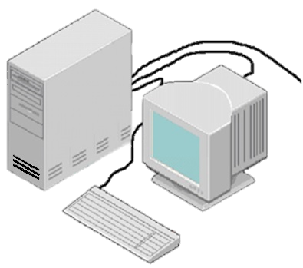
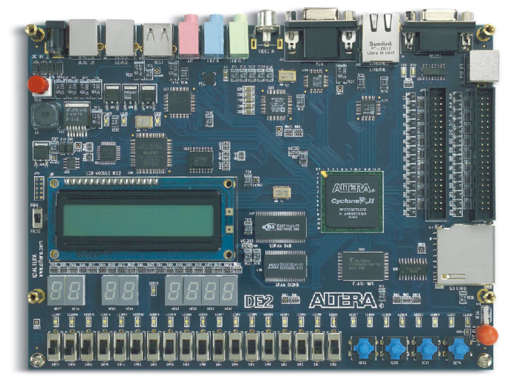
Programming an FPGA
Loading a compiled file into the FPGA memory (SRAM or EPROM)
Notes:
Bit file - Generated during implementation of the design.

Slide 28
Summary
Getting familiar with different architectures of FPGAs
Understanding Logic Elements and how to program them
Understanding Switching matrices and how to program them
Mapping and partitioning of logic circuits to FPGA boards

Slide 29
Mapping to 3x2 LUTs
Example: Mapping a 2x4 decoder to 3-input 2-output LUTs
d0
8x
2
Mem.
8x
2
Mem.
0
10
0
00
d1
1
01
1
00
Sub-circuit has 2 inputs, 2 outputs
2
00
2
10
d2
3
00
3
01
0
a2
4
00
0
a2
4
00
i1
a1
a1
d3
i0
a0
5
00
a0
5
00
Sub-circuit has 2 inputs, 2 outputs
6
00
6
00
7
00
7
00
D1
D0
D1
D0
(b)
(a)
i1
i0
d0
d1
d2
d3

Slide 30
FPGAs With Numerous Small LUTS
Example: 9-input circuit more efficient on 8x1 mems rather than 512x1
a
a
512x
1
M
em.
b
b
3x1
c
c
d
d
e
F
e
3x1
3x1
F
8x
1
M
em.
f
f
g
g
h
h
3x1
i
i
(
a
)
(
b
)
(
c
)
Partitioned among 3x1 LUTs
- Requires only 4 3-input LUTs (8x1 memories)
- Much smaller than a 9-input LUT (512x1 memory)
Original 9-input circuit

Slide 31
3.3. Example 3: Underutilized LUTs
Find the mapping of the circuit shown in Example 2 if the input d is dropped
k
p
8x1
Mem
.
8x1
Mem
.
s
w
0
0
0
0
t
1
0
1
1
k
2
0
2
1
p
x
3
0
3
1
(a)
s
w
k
a2
0
a2
t
p
a1
4
0
a1
4
0
s
a0
5
0
a0
5
0
6
1
6
0
(b)
7
0
7
0
Sub-circuit has only 2 inputs
D
D
t
x
w
(c)
Italics: contents don’t matter

